Slide 1
USST’s System for AutoSimTrans 2022
Jiahui Zhu ¹, Jun Yu ²
¹ University of Shanghai for science and technology
² East China University of Science and Technology

Slide 2
Outline
Tracks
Data and preprocessing
Text-to-text system
Conclusion

Slide 3
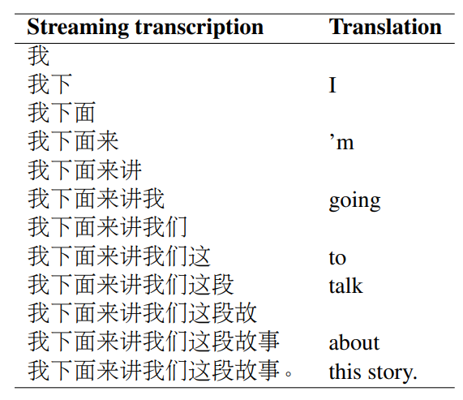
Tracks
We participated in two streaming transcription track:
Zh→En Translation. (text-to-text)
En→Es Translation. (text-to-text)

Slide 4
Data and preprocessing
Datasets
Zh→En: We pretrained our MT model on CWMT21 (9.1M) and fine-tined on Baidu Speech Translation Corpus (39K).
En→Es: We trained our MT model on UN Parallel Coupus (21M).
Preprocessing
Word Segmentation.
Length filter.
Langage identification.
Deduplication.
Byte-pair-encoding.

Slide 5
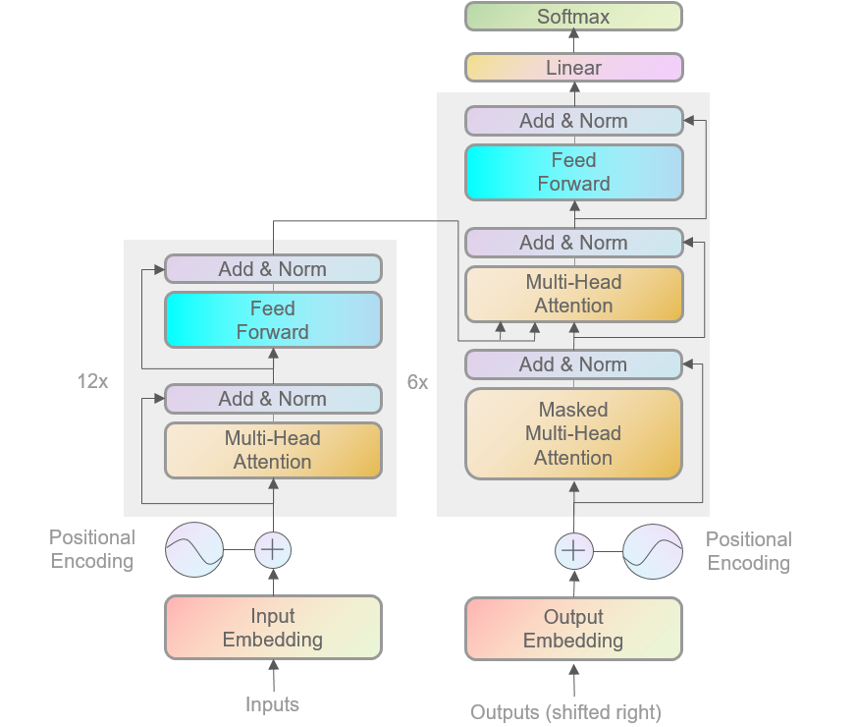
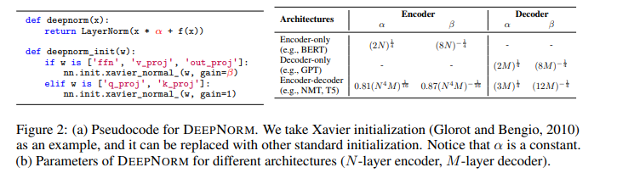
Text-to-text system
1. For abtaining rich source representations, we train a Transformer base with 12 layer encoder.
2. For stabilize training , we initialize the model with the method mentioned in DeepNet.

Slide 6

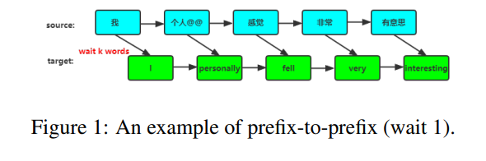
Text-to-text system
3.For domain adaption, we use in-domain data filtering to mine data from CWMT that is most similar to BSTC, and then mix it with BSTC for fine-tuning.
4. To reduce the latency, we adopt fixed read/write policy wait-k.

Slide 7
Conclusion
1. This paper describes our text-to-text simultaneous translation system, which uses a deep Transformer to improve translation quality and adopt wait-k policy to reduce latency.
3. We plan to research on some dynamic read-write policies in order to better balance quality and latency.

Slide 8
Thank you！

